Slide 1







1
Full stack development
SAFE CITY: CRIME LIFE IDENTIFICATOR
IT1CCO - 2402IS
By Zholdasbay Karina
Khairulla Amir
Teacher: Sydyqbek Zhanibek Qanatuly

Slide 2







2
PROJECT FIELD AND PROBLEM
Field: Public Safety and Digital Technologies
Problem: People lack access to real-time information about crime risks in different areas of the city and a simple way to report incidents and quickly request emergency assistance.

Slide 3
3
PROJECT GOAL
The main goal is to develop a digital public safety platform that enables users to assess the safety level of different areas, choose safer routes, report incidents, and quickly contact emergency services.

Slide 4

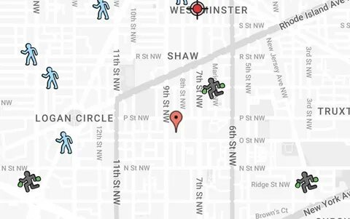
4
td
Analogue solutions
SpotCrime is a website and app that provides crime maps and recent crime reports by location. It helps users see where incidents such as theft, assault, burglary, and vandalism have occurred and check local crime trends.
https://spotcrime.com

Slide 5
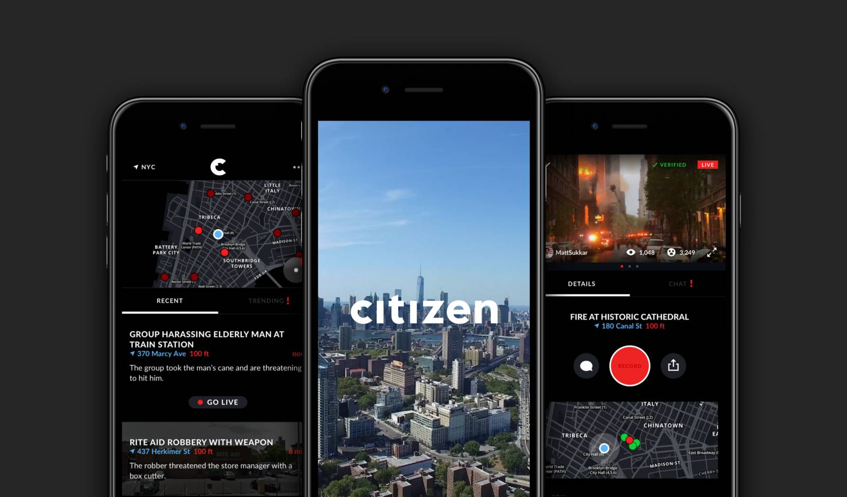

5
Analogue solutions
Citizen is a safety app that provides real-time alerts, incident updates, and live video about emergencies and public safety events nearby. Users can search incidents, receive notifications, and share information with their community.
https://citizen.com

Slide 6
CITY CRIME MAP

Slide 7
6
LIMITATIONS
  These solutions mainly display already recorded crimes (excl. Citizen), making it less suitable for real-time incident reporting and emergency assistance, many of features rely on local (USA) data sources and require complex moderation of user-generated reports (excl. Crime Map) and therefore poorly adapted to the needs of Kazakhstan.

Slide 8

7
ANALYSIS
Existing services address individual parts of the problem, but they do not combine them into a single local safety system adapted to Kazakhstan. Safety information, citizen reports, and access to emergency assistance are currently handled separately. Our project brings these capabilities together in one convenient digital platform.

Slide 9

8
RESULT
  Our project aims to combine functions presented independently in other apps/websites into one integrated application designed specifically for Kazakhstan. The functions are:
  Emergency Response, to provide quick access to police, ambulance, and other emergency services.
  Safe Navigation, to suggest safer routes based on crime levels and recent incidents.
  Crime Map, to view crime levels and types of incidents by streets and districts.
  Citizen Reporting, to allow residents to report incidents and document them with photos, videos, or descriptions.

Slide 10


9
CONCLUSION
Our project aims to create a single, accessible safety platform for Kazakhstan. It can help people stay informed about their surroundings, make safer decisions, and respond more effectively to dangerous situations.
By bringing these needs together in one place, we can make everyday life safer, more connected, and more secure for citizens.

Slide 11

10
THANK YOU

